Slide 1
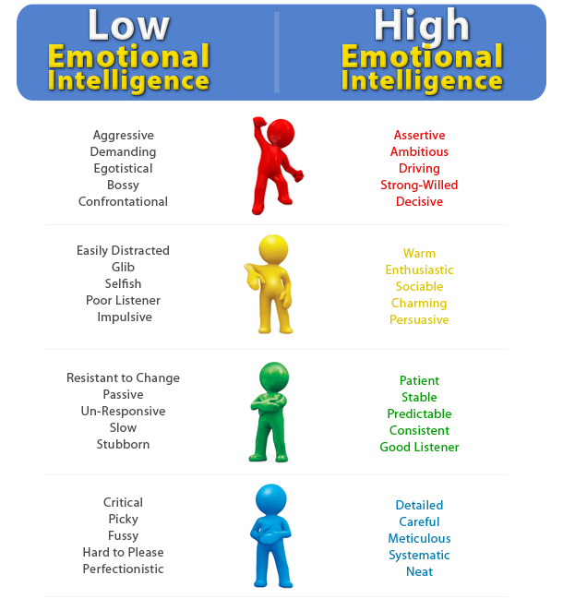
DISC and EIQ-2
-
+
-
+
Critical
Picky
Fussy
Careful
Detailed
Neat
Aggressive
Demanding
Egotistical
Assertive
Ambitious
Leader
-
+
-
+
Passive
Slow
Stubborn
Patient
Stable
Consistent
Selfish
Poor Listener
Impulsive
Charming
Enthusiastic
Sociable
Minus Sign = Low Emotional Intelligence
Plus Sign = High Emotional Intelligence

